Slide 1
Iterative Model
Prepared By- Prasad Taware
Jaydip Patil

Slide 2
What is Iterative Model
In iterative model the organization start with some of the software specification and develop the first version of the software.
After the first version if there is a need to change the software then a new version of the software is created with a new iteration.
It will repeat until deployment of the software.

Slide 3
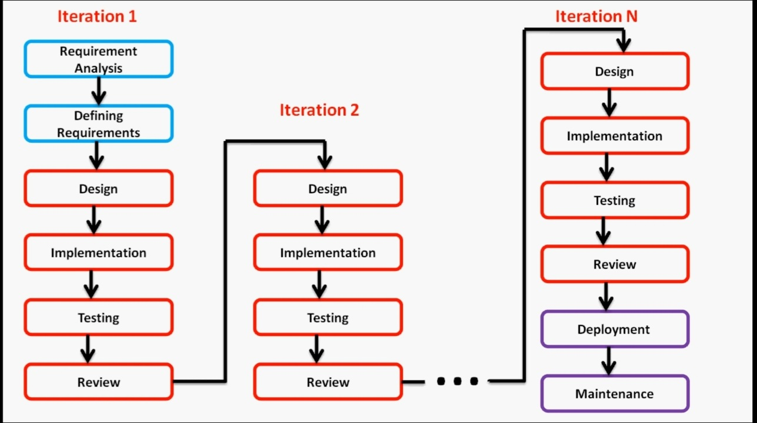
Block Diagram

Slide 4
When to use iterative model
Requirements of the complete system are clearly defined and understood.
When the project is big.
Major requirements must be defined; however, some details can evolve with time.

Slide 5
Advantages of Iterative Model
Generates working software quickly and early during the software life cycle.
Easier to test and debug during a smaller iteration.
Easier to manage risk because risky pieces are identified and handled during its iteration.
Each iteration can be easily managed.

Slide 6
Disadvantages of Iterative Model
It is not suitable for smaller projects.
It is not suitable for changing requirements.
More management attention is required.
End of project may no be known, which is a risk.
Project progress is highly dependent upon the risk analysis phase.

